Slide 1

Prepared by group 28
Applied Statistics Project
“Mental Well-being and Associated Attributes”
Spring 2025

Slide 2
Team 28 members:
Devesh Gautam (MA23BTECH11009)
Sivanesan (MA23BTECH11024)
Ansh Bhatia (MA23BTECH11003)
Table of Contents:
Introduction
Data Collection
Data Visualisation
Insights
Correlation
Central Limit Theorem
Final Thoughts

Slide 3
Introduction
For our project, we decided that our goal would be to find the “happiness” of students and other stuff about their lives at college, to see if we could find some correlation among other interesting insights.
Our entire project can be divided into roughly three phases: Data collection, Data visualisation, and inferences and insights.

Slide 4
Data Collection
The survey and the steps

Slide 5
Survey
Since our project was very student oriented, we decided to do the data collection ourselves rather than rely on online databases.
The advantage was that we could tailor the questions according to our specific requirements, the disadvantage being that we were limited in our sample size among other biases (we’ll get into that later).
We proceeded with a Google Form, made a survey of about 20 questions, and floated it among our friends and peers.
We were able to collect ~80 responses which was much higher than our expectations and certainly much more than the required 30.
As for the questions themselves, we wanted to keep it completely anonymous so we didn’t ask students any other identifier except their year of study and whether they were UG or PG.
Other questions can be mostly broken down into academics, extracurriculars, and lifestyle choices. Lastly we asked some more direct questions about happiness and mental well being.
For a lot of these questions, we recorded the responses on a scale of 1-10

Slide 6
The Questions we asked
Identifiers:
Lifestyle:
Under-grad or Post-grad?
Which year are you in?
On a scale of 1-10, how much of a physical person are you (in terms of your engagement with sports, gym, etc.)?
On a scale of 1-10, how would you describe your sleep schedule?
On a scale of 1-10, how much of a night-owl are you?
On a scale of 1-10, how regularly do you engage in meditative activities?
Academics:
On a scale of 1-10, how would you describe your class attendance?
On a scale of 1-10, how would you describe the difficulty of your branch?
What is your CGPA?
Extracurriculars:
How many clubs/cells have you been a part of?
On a scale of 1-10, how involved are you with clubs/cells activities/events (includes the clubs you are not part of)?
To see our actual form, click here.

Slide 7
Can’t really categorize:
More direct Happiness indicators:
On a scale of 1-10, how much do you keep up with current events? (News/Politics)
On a scale of 1-10, how involved are you with religion?
How regularly do you listen to music?
How would you rate the happiness level of the type of music you listen to most on a scale of 1-5?*
On a scale of 1-10, how connected and supported do you feel by the people around you? (Family, Friends, etc.)
On a scale of 1-10, how often do you feel positive emotions (joy, excitement, contentment) compared to negative ones (sadness, stress, frustration)?
On a scale of 1-10, how satisfied are you with your life as a whole right now?
On a scale of 1-10, how happy do you feel in general?

Slide 8
Pre-Processing
On our side, there wasn’t much to pre-process, since we asked only for numeric answers. There was a little bit of clean-up we had to do, for example, one respondent wrote “2nd” instead of “2” for a question, so we had to go in and manually correct that.
Luckily, our sample size was small enough that we could manually find and correct these little discrepancies.
There were some questions which were actually non-numerical but we converted them into their numerical counterparts by just listing what the specific numbers meant in the question itself.

Slide 9
Data Visualisation

Slide 10
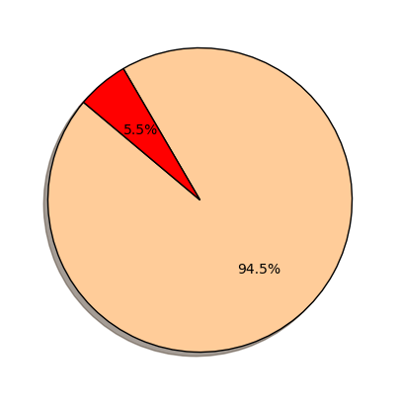
Under-grad or Post-grad?
Most of the data was collected among our friends and peers, and since we’re UG students ourselves, it is a given conclusion there’ll be over-representation of UG students in our survey, but even we weren’t expecting so little PG students. Maybe we should’ve reached out more.
Total Responses - 76
Under-grad - 71
Post-grad - 5

Slide 11
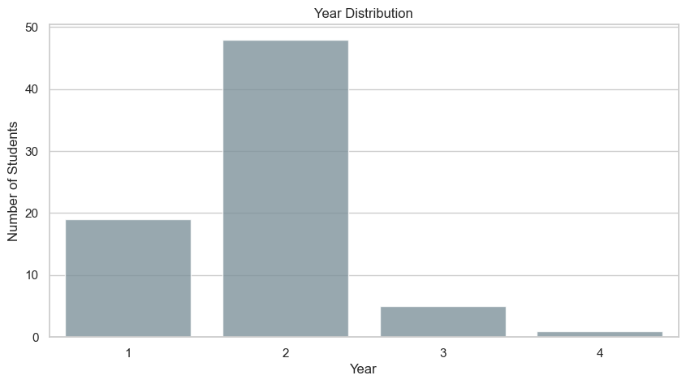
Which year are you in?
Again, similar to UG or PG, since we’re 2nd year students ourselves, it was expected that most of the responses will be from fellow 2nd year, although we did get considerable 1st year representation which is nice.
Total Responses - 76
1st years - 19
2nd years - 48
3rd years - 5
4th years - 1

Slide 12
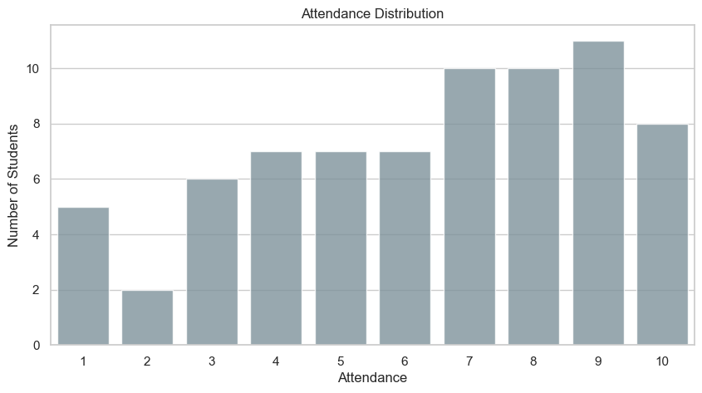
Class Attendance
Q: On a scale of 1-10, how would you describe your class attendance?
In the question, we specifically mentioned what the extremes (1 & 10) represent.
That means 8 responders haven’t missed a class in the last two weeks.
More interestingly, 5 responders do not know the name of their professors.

Slide 13
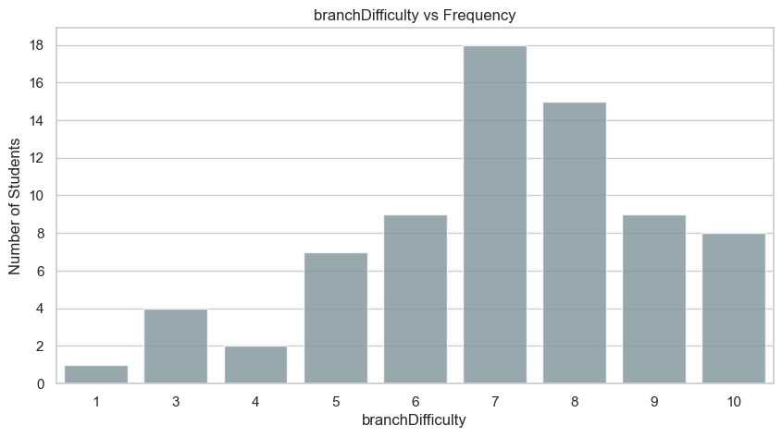
Difficulty of your branch
Q: On a scale of 1-10, how would you describe the difficulty of your branch?
Most people believe their branch is moderately difficult (7-8). Interestingly though. at the extremes there’s a significant skew towards people who believe their branch to be most difficult compared to those who believe theirs to be relatively easy.

Slide 14
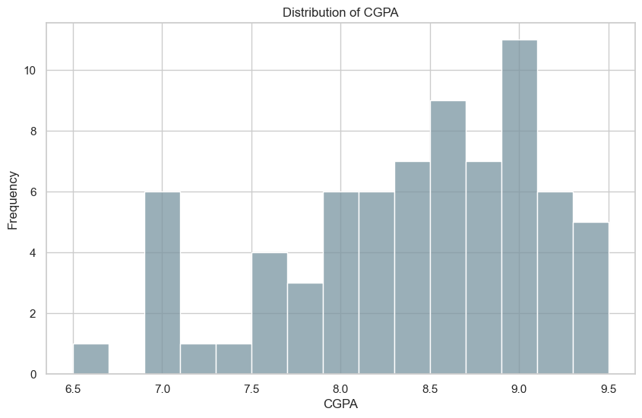
What is your CGPA?
Most responders have their CGPA in the 8-9 range. Almost no one has less than 7. No one has greater than 9.5

Slide 15
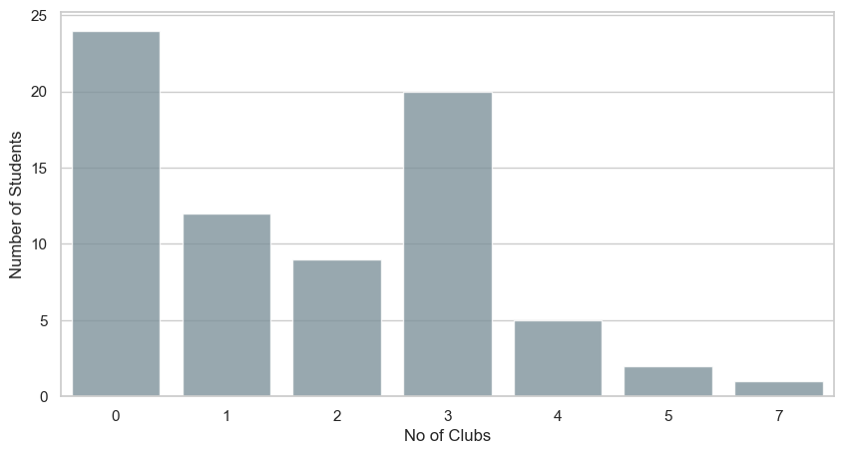
Number of Clubs/Cells joined
Q: How many clubs/cells have you been a part of?

Slide 16
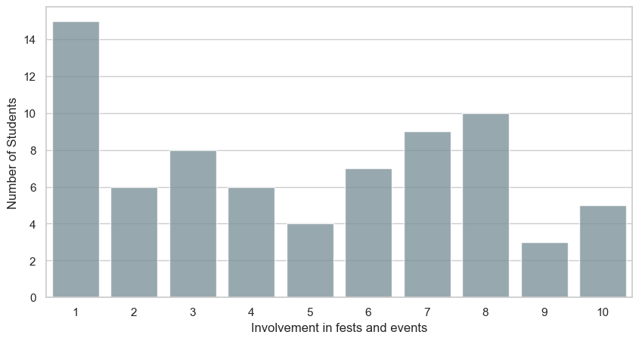
Participation in activities organised by clubs/cells
Q: On a scale of 1-10, how involved are you with clubs/cells activities/events (includes the clubs you are not part of)?

Slide 17
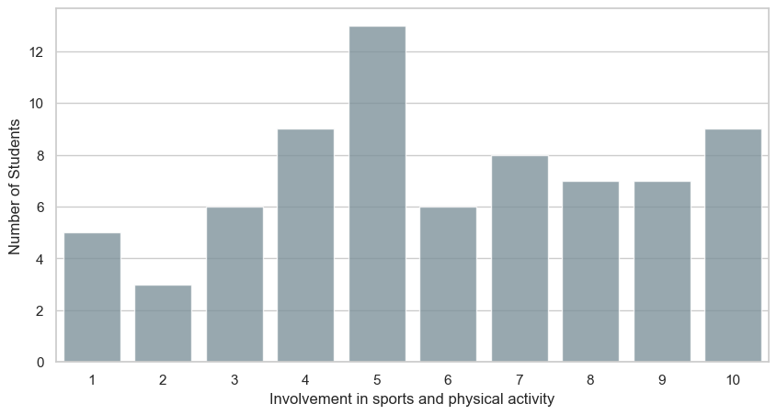
How involved are you with sports/gym etc.?
Q: On a scale of 1-10, how much of a physical person are you (in terms of your engagement with sports, gym, etc.)?

Slide 18
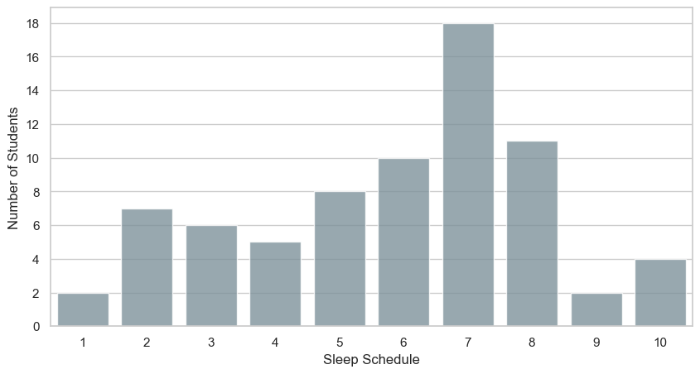
Sleep Schedule
Q: On a scale of 1-10, how would you describe your sleep schedule?

Slide 19
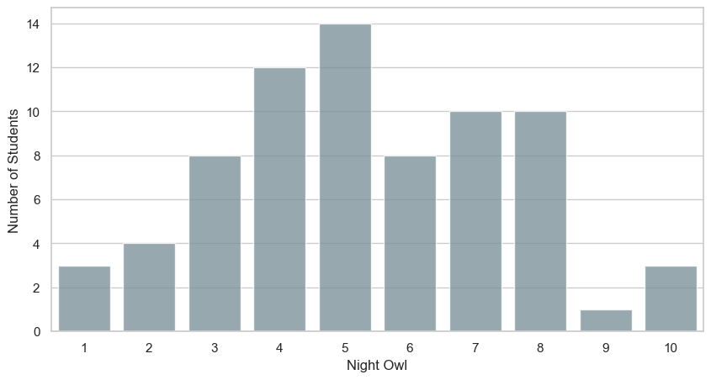
How much of a night-owl are you?
Q: On a scale of 1-10, how much of a night-owl are you?

Slide 20
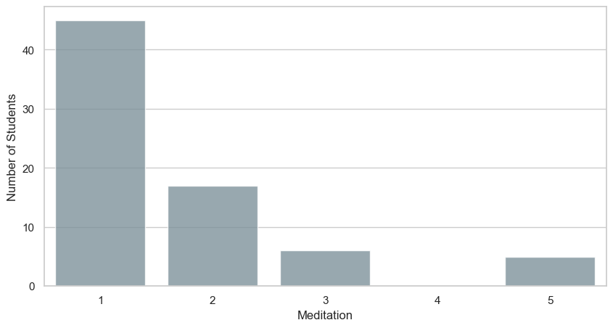
How regularly do you engage in meditative activities?
Q: On a scale of 1-10, how regularly do you engage in meditative activities?

Slide 21
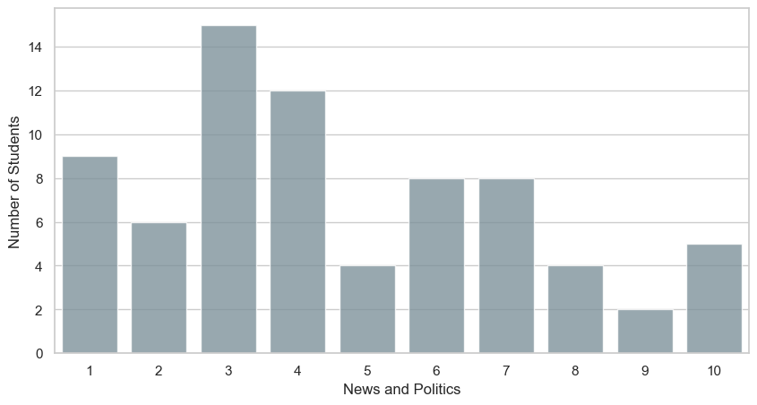
How much do you keep up with current events?
Q: On a scale of 1-10, how much do you keep up with current events? (News/Politics)
There is a strong apparent bias to the left, that is towards the apolitical side of things, which makes sense since this is an engineering college.

Slide 22
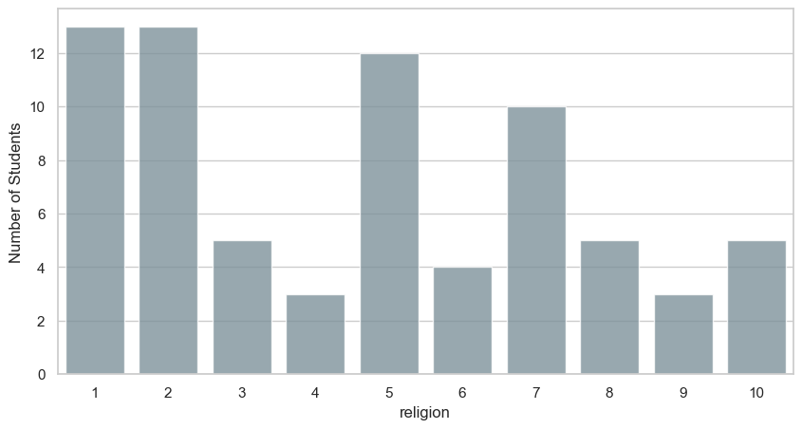
How involved are you with Religion?
Q: On a scale of 1-10, how involved are you with religion?

Slide 23
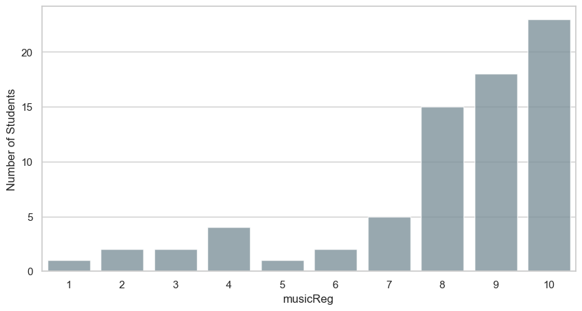
How regularly do you listen to music?

Slide 24
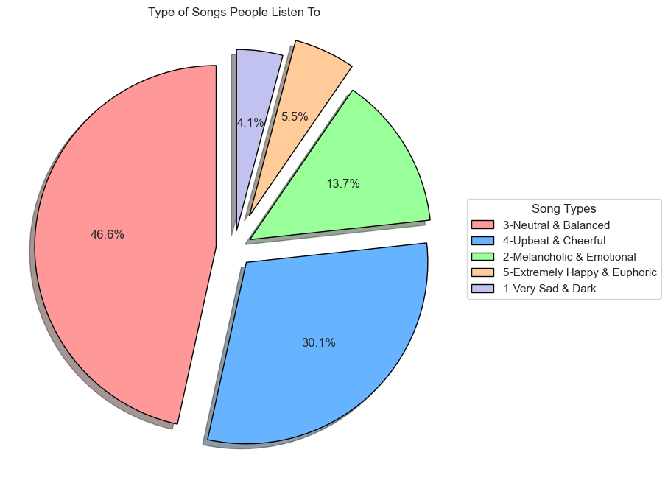
Type of Music
Q: How would you rate the happiness level of the type of music you listen to most on a scale of 1-5?
1-Very Sad & Dark 3
2-Melancholic & Emotional 10
3-Neutral & Balanced 34
4-Upbeat & Cheerful 22
5-Extremely Happy & Euphoric 4

Slide 25
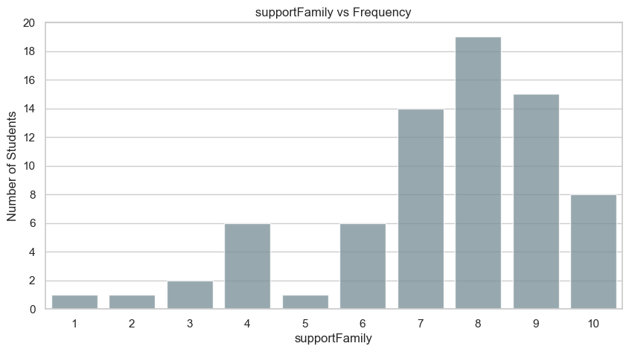
How supported do you feel by the people around you?
Q: On a scale of 1-10, how connected and supported do you feel by the people around you? (Family, Friends, etc.)

Slide 26
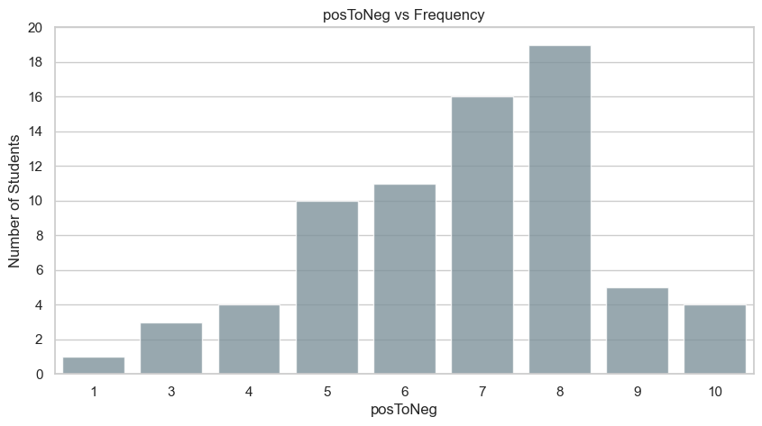
How often do you feel positive emotions compared to negative ones?
Q: On a scale of 1-10, how often do you feel positive emotions (joy, excitement, contentment) compared to negative ones (sadness, stress, frustration)?

Slide 27
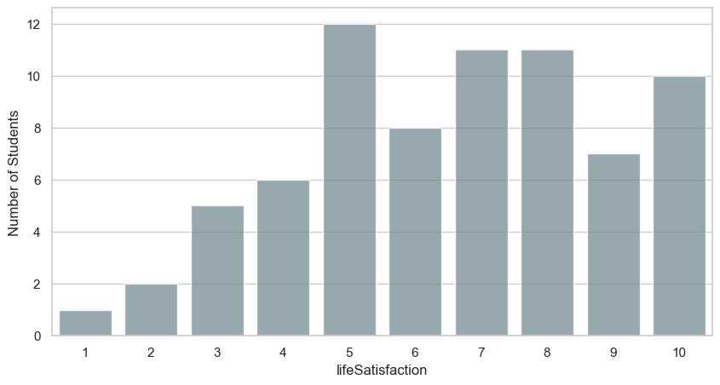
How satisfied are you with life as a whole right now?
Q: On a scale of 1-10, how satisfied are you with your life as a whole right now?

Slide 28
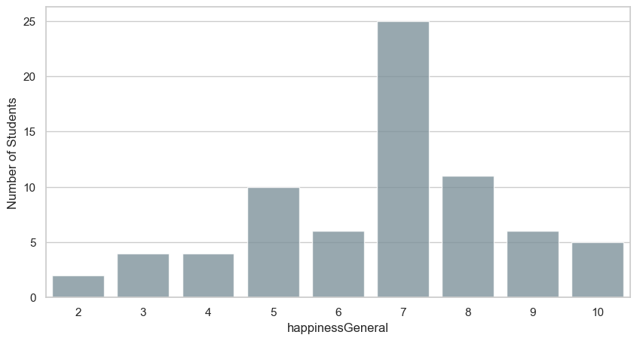
How happy do you feel?
Q: On a scale of 1-10, how happy do you feel in general?

Slide 29
Insights
with a focus on measures of central tendency & dispersion

Slide 30
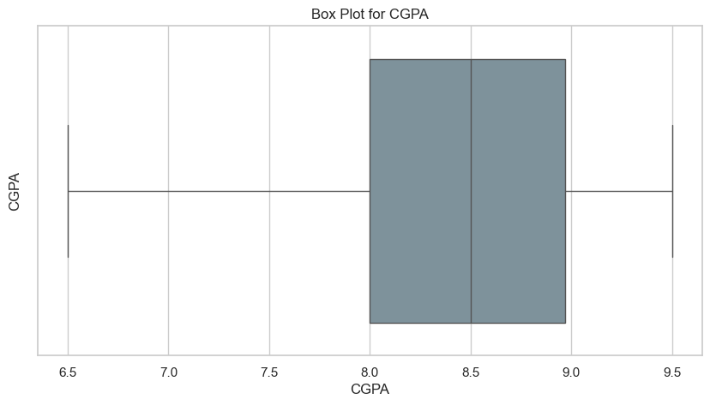
CGPA
There are a lot of questions which ask the responders to rank themselves. CPGA is one of the few questions we asked which gave us an objective view into a student’s academic situation.
The measure of central tendency & dispersion corresponding to CGPA are as follows:
Mean - 8.37
Standard deviation - 0.72
Median - 8.50
Variance - 0.51
Minimum - 6.50
Maximum - 9.50

Slide 31
Insights for CGPA
The median of 8.5 tells us that at least half of the responders have a CGPA less than or equal to 8.5, which is impressive.
The average CGPA is 8.37.
With a minimum and maximum of 6.5 and 9.5 respectively, the range of the CG’s comes out to 3.
With that in mind, the standard deviation of 0.72 indicates a high level of variation among the range, but still closely centered around the mean of 8.5
From the Box plot and the quartiles, we can infer that roughly half of the responses fall within the 8 to 9 CGPA range (Interquartile Range).

Slide 32
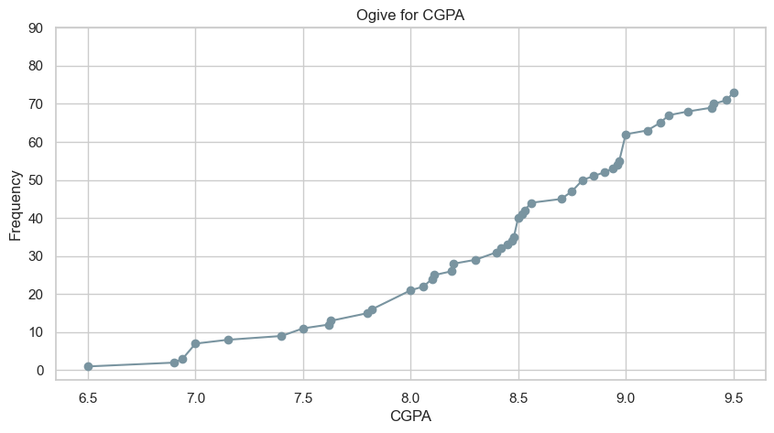

Slide 33
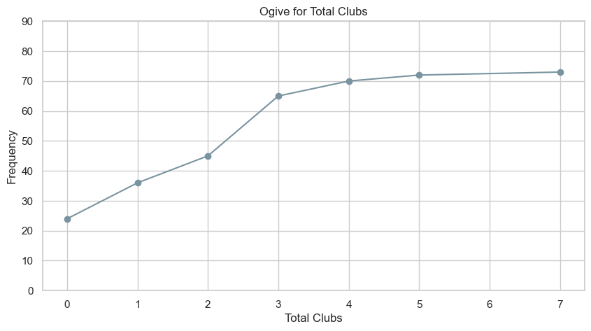
Total Clubs
Total clubs is a tricky variable in the sense that, it does not directly correlate with involvement in said clubs. One may join a lot of clubs but put minimal effort in them, whereas someone else may join a single club but be heavily involved in its working. Hence, one should take care while analyzing its behaviour. The measures of central tendency & dispersion are as follows:
Mean - 1.73
Standard deviation - 1.60
Median - 2.0
Variance - 2.56
Minimum - 0
Maximum - 7

Slide 34
Insights for Total Clubs
The median (=2) tells us that at least half of the responders have joined 2 clubs or less.
From the bar graph and the ogive, we can infer that, at the extremes, it is much more likely for a responder to have joined 0 clubs than to have joined many (>=4) clubs.
From the bar graph, we can see that, among those who have joined clubs, most of them join around 2-3 clubs.
The maximum number of clubs joined by a responder is 7.
The range is 7, whereas the standard deviation is 1.6, indicating moderate deviation of values from the mean of 1.73.

Slide 35
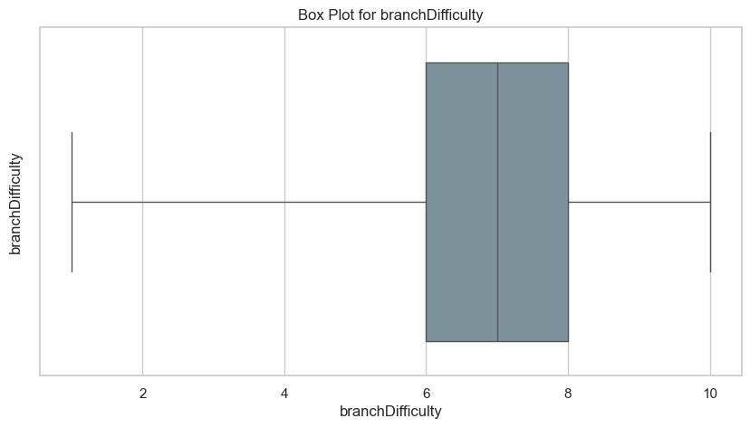
Branch Difficulty
“Branch difficulty” shouldn’t be taken at face value, as it is the difficulty of the branch as perceived by the respondent, rather than some objective difficulty, if such a thing even exists. The measures of central tendency & dispersion for Branch Difficulty are as follows:
Mean - 7.08
Standard deviation - 1.96
Median - 7.0
Variance - 3.68
Minimum - 1.0
Maximum - 10.0
1st Quartile - 6.0
3rd Quartile - 8.0

Slide 36
Insights for Branch Difficulty
A median of 7 tells us that at least half of the responders consider the difficulty of their branch to be less than or equal to 7.
With a minimum of 1, and a maximum of 10, and the fact that it is a discrete variable, the range comes out to be 10.
From the quartiles and the box plot, we can infer that around half of the responders consider the difficulty of their branch to be moderately high (6-8).
With a standard deviation of 1.96, we can infer that the deviation is low with most of the values lying around the mean of 7.

Slide 37
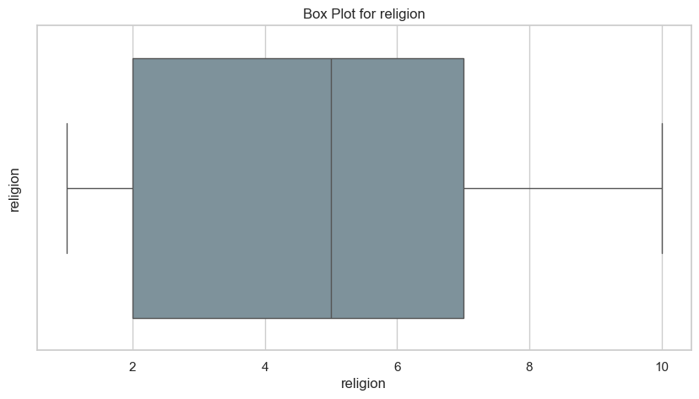
Religion
How does one measure involvement with a religion? Everyone has a different concept of faith. To try to objectivize something as subjective as that, would be very difficult. The measures of central tendency & dispersion for Religion are as follows:
Mean - 4.61
Standard deviation - 2.88
Median - 5.0
Variance - 8.29
Minimum - 1.0
Maximum - 10.0
1st Quartile - 2.0
3rd Quartile - 7.0

Slide 38
Insights for Religion
A median of 5 tells us that at least half of the responder rate the extent of their involvement with religion a 5.
The range of the distribution is 10.
From the box plot, we infer that a quarter of the extent of their involvement with religion to be minimal (1).
Only a quarter of the responders rate their involvement greater than or equal to 7.
A standard deviation of 2.88 indicates a high degree of deviation of the distribution around the mean value of 4.61.

Slide 39
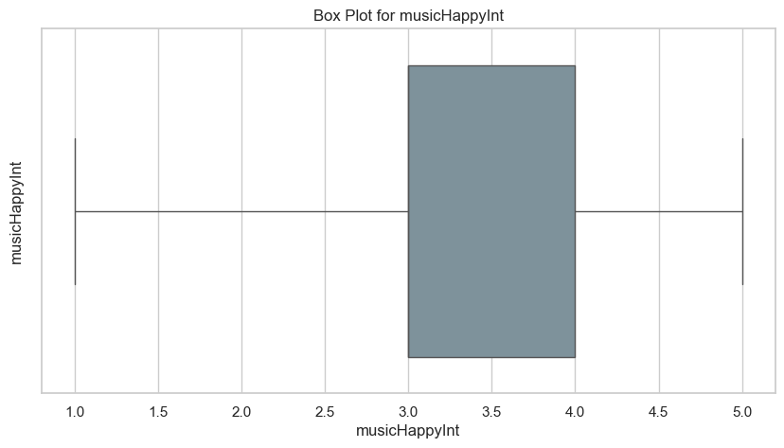
Type of music
We gave responders the option to choose from 1 to 5, where we assigned a “vibe”/emotion of music to each number as follows: 1 (Sad & Dark), 2 (Melancholic & Emotional), 3 (Neutral & balanced), 4 (Upbeat & Cheerful), 5 (Extremely happy & Euphoric). The measure of central tendency & dispersion for Type of music are as follows:
Mean - 3.19
Standard deviation - 0.89
Median - 3.0
Variance - 0.79
Minimum - 1.0
Maximum - 5.0
1st Quartile - 3.0
3rd Quartile - 4.0

Slide 40
Insight for Music
The median of 3.0 indicates that half of the respondents prefer music that is "Neutral & balanced" or more upbeat, while half prefer this neutral category or more melancholic music.
With a mean of 3.19, the overall preference leans slightly toward more upbeat music compared to the exact middle of the scale.
The standard deviation of 0.89 suggests moderate variability in preferences, indicating that most responses cluster somewhat near the middle of the scale.
The interquartile range is narrow (3.0 to 4.0), meaning that the middle 50% of respondents are concentrated between "Neutral & balanced" and "Upbeat & Cheerful" categories.
Both the 1st quartile and median being 3.0 tells us that at least 25% of respondents chose exactly the middle option, suggesting a substantial portion prefer balanced music.

Slide 41
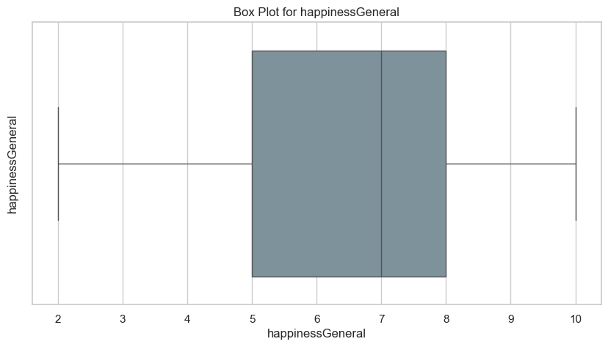
Happiness
Happiness, as one would expect, is hard to measure. We dealt with this predicament by allowing the respondent the full control of what they believe to be their “happiness”. To make sure that they at least considered several aspects of happiness, we made sure to keep questions relating to these aspects (Satisfaction, safety nets, etc.) before the the actual question of happiness. The measures of central tendency & dispersion for Happiness are as follows:
Mean - 6.64
Standard deviation - 1.92
Median - 7.0
Variance - 3.62
Minimum - 2.0
Maximum - 10.0
1st Quartile - 5.0
3rd Quartile - 8.0

Slide 42
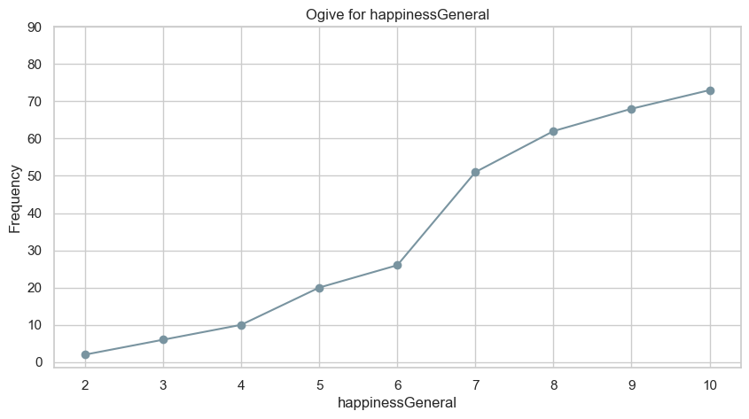

Slide 43
Insight for Happiness
The median happiness score of 7.0 on a scale of 1-10 indicates that half of the respondents rated their happiness at 7 or higher, suggesting a generally positive self-assessment of happiness among participants.
With a mean of 6.64, the average happiness score is slightly lower than the median, indicating the distribution is slightly skewed toward the lower end of the scale.
The standard deviation of 1.92 represents moderate variability in happiness scores, showing diversity in how people assess their own happiness.
The range spans from 2.0 to 10.0, with no one selecting the absolute lowest score of 1, suggesting that even the least happy respondents didn't consider themselves to be at the extreme negative end of the scale.
The absence of scores at the absolute minimum (1.0) combined with responses reaching the maximum (10.0) suggests a slight positive skew in how people evaluate their happiness.

Slide 44
Further Insights for Happiness
Grouping Happiness by Year:
Since we have significant responders for year 1 & 2 only, lets focus only on those.
We find that the mean happiness for first years is 7.06, whereas for second years it is 6.41.
This suggests that there is a slight decrease in overall happiness as a student progresses from year 1 to year 2, although we cannot make any concrete claims based on the size of the survey.
Year of study | Mean | Median | Standard Deviation
1st | 7.06 | 7.0 | 1.75
2nd | 6.41 | 7.0 | 2.0

Slide 45
Correlation
and associated insights

Slide 46
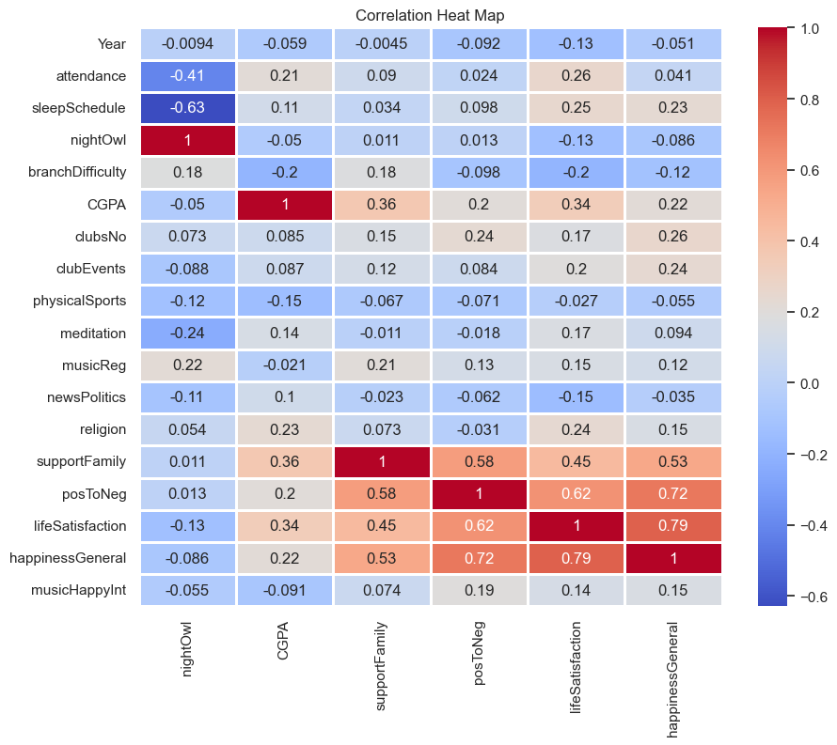
Pearson Correlation Coefficient
In this next part, we will focus on the insights gained from pairs of attributes/variables where the Pearson Correlation Coefficient has a significant value between the pair.
On the left is a heatmap of correlation between attributes. The Y-axis consists of all the attributes we’ve discussed. The X-axis consists of several hand-picked attributes that we found interesting for the purpose of correlation.

Slide 47
Night-owl & Attendance
The correlation coefficient between the two is -0.41.
The ‘-’ represents that on increasing the value of one, the other one decreases. The magnitude represents the extent of correlation. A ‘0' represents no correlation between the variables whatsoever, whereas a ‘1’ represents perfect correlation, i.e., both variables will have the exact same values.
A ‘-0.41’ correlation represents significant negative correlation, i.e., for a given student, the more of a night-owl they are, the less will be their attendance in class and vice-versa.
Correlation does not equal causation, but in this specific case, we can very reasonably assume that if a student studies mainly in the night until 3 or 4 am, they will find it very hard to come to the morning classes.
Attendance & CGPA
The correlation coefficient between the two is 0.21.
A ‘0.21’ represents a positive correlation, which is to be expected, but the extent of the correlation is very less, implying that Attendance is not as big a part of CGPA determination.
Again, Correlation does not mean causation.

Slide 48
CGPA & Safety nets (Family, friends)
The correlation coefficient between the two is 0.36.
A ‘0.36’ coefficient implies a moderate, yet significant positive correlation.
The hypothesis implication being that a strong safety net allows students to perform better academically.
Safety nets & Happiness
The correlation coefficient between the two is 0.53.
A ‘0.53’ coefficient implies a strong and significant positive correlation between the existence of strong safety nets for the student and their overall happiness.
Our reasoning is as follows: Strong safety nets imply strong relationships and a good social life, all of which are a major part of what makes someone happy.
We’d like to reiterate that correlation does not equal causation, and with the small data that we have, we cannot reasonably make any concrete assertions.
With that said, the relationship between safety nets & happiness seems like a foregone conclusion.

Slide 49
Happiness & CGPA
The correlation coefficient between the two is 0.22.
A positive correlation, as one would expect, but at the same time, the extent of the correlation is very small.
CGPA doesn’t have as significant of an impact on happiness as one may be led to believe.

Slide 50
Central Limit Theorem
and associated insights

Slide 51
The Central Limit Theorem (CLT) states that the distribution of the sample means (or sums) of a large number of independent, identically distributed variables will be approximately normally distributed, regardless of the original distribution of the variables. This approximation improves as the sample size increases.
In this next section, our objective is to show the “functioning” of the CLT with different distributions (owing to the large number of questions we surveyed), and show that regardless of the nature/shape of the original distribution, given enough sample means, the distribution approximates a normal distribution.

Slide 52
What are we doing?
We are sampling means from the collected data and then we are plotting the histogram for the sample means, in the same graph we are plotting the normal distribution to compare both the graphs. Now to find the parameters for Normal distribution we are using the central limit theorem (as the sampling is randomly distributed),
we use the formulae:
Mean (normal distribution) = Mean of the sample means
Standard Deviation (normal distribution) = Standard Deviation of sample means

Slide 53
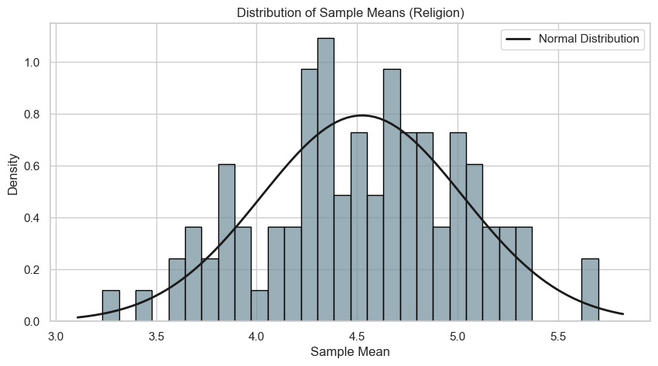
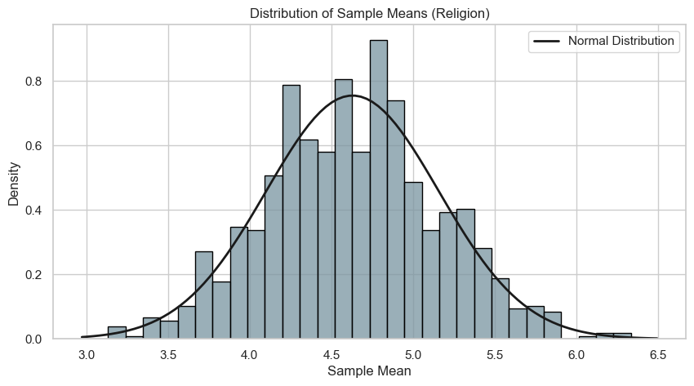
CLT application on Religion Variable
Size of each Sample - 30
Number of Samples - 100
Size of each Sample - 30
Number of Samples - 1000

Slide 54
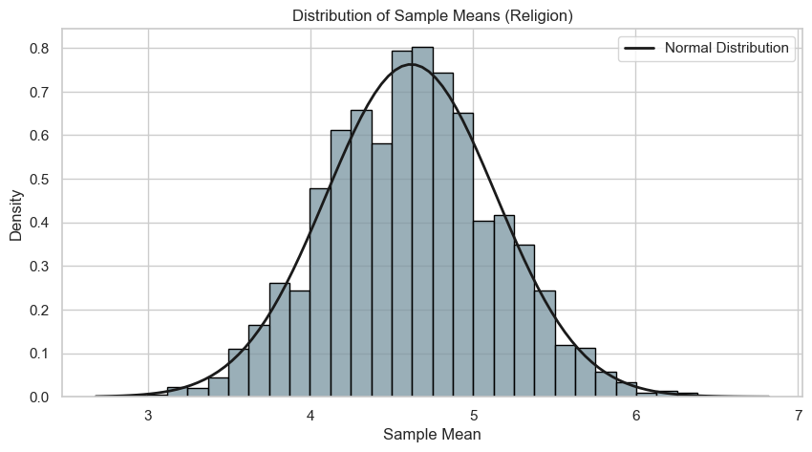
Size of each Sample - 30
Number of Samples - 10000

Slide 55
Explanation
What we’re doing here is randomly selecting samples of 30 out of the total responses, and for each collection we define a variable that outputs the sample of that mean. It is on the mean of these new variables that we apply the CLT on.
The “size of a sample” signifies the size of a selection. The “number of samples” signifies the number of selections. As we can see in the two previous slides, on increasing the number of samples, that is, on increasing the number of sample means, the distribution of their mean, better approximates a normal distribution.
Let us apply CLT once more to better understand its working.

Slide 56
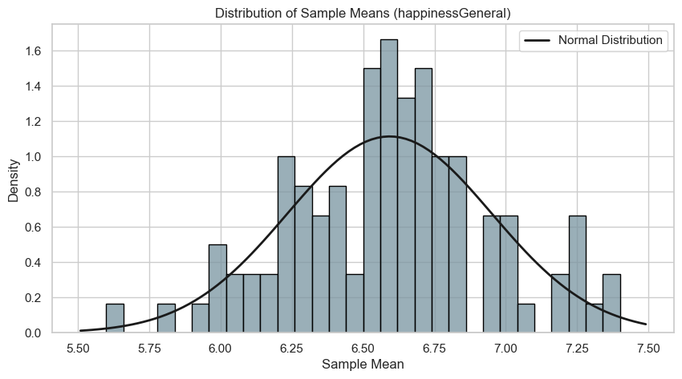
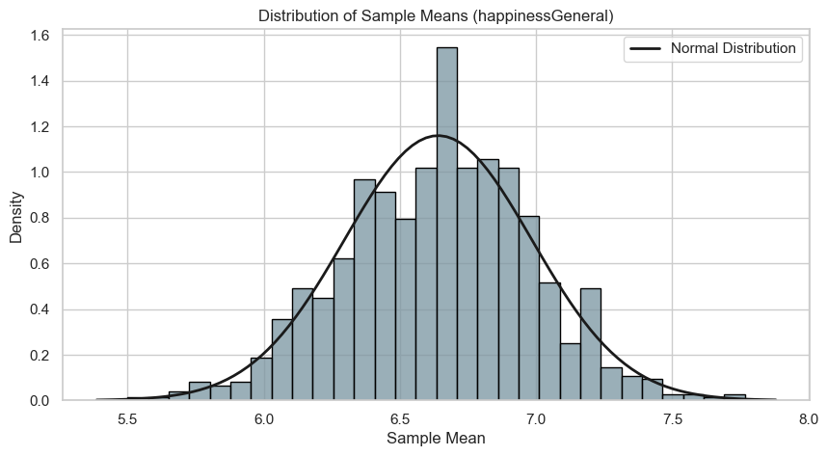
CLT application on Happiness Variable
Size of each Sample - 30
Number of Samples - 100
Size of each Sample - 30
Number of Samples - 1000

Slide 57
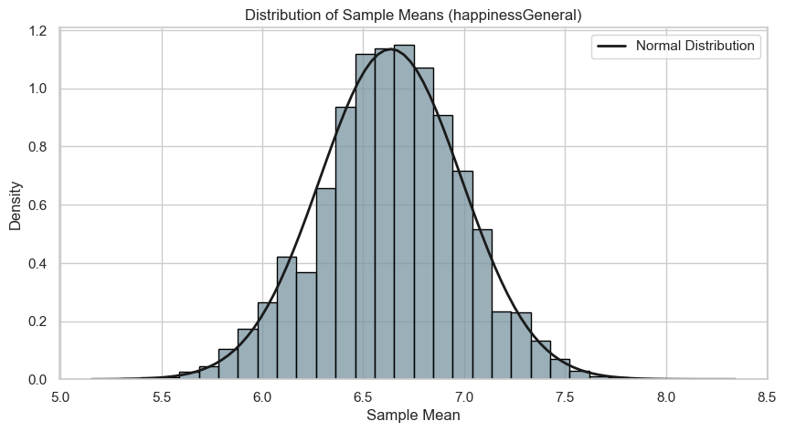
Size of each Sample - 30
Number of Samples - 10000

Slide 58
Some pointers about the graph
X-Axis (Sample Mean):
The x-axis represents the sample means of the Happiness attribute.
Each value on the x-axis corresponds to the mean of a random sample of size 30 taken from the Happiness data.
Y-Axis (Density):
The y-axis represents the density of the sample means.
Density is calculated as the count of sample means in each class interval divided by the total number of sample means and the interval width.
The area under the histogram is normalized to 1.
Bars of the Histogram:
Each bar represents the frequency (density) of sample means falling within a specific range (class interval).
The height of each bar indicates how densely the sample means are distributed within that range.
Overlaying Curve (Normal Distribution):
The overlaying curve is a normal distribution (Gaussian) fitted to the sample means.
The curve is generated using the mean and standard deviation of the sample means.
It represents the theoretical distribution of the sample means according to the Central Limit Theorem (CLT).
The curve helps to visually verify if the distribution of sample means approximates a normal distribution.

Slide 59
Final Thoughts
Drawbacks and deliberations

Slide 60
Conclusions
Safety nets (Family, friends) have a high correlation with happiness indicators such as Overall Happiness, Life Satisfaction, etc.
CGPA doesn’t seem to affect happiness indicators in a significant way.
The type of music someone listens to doesn’t correlate to their happiness indicators.
Being a night owl has a significant correlation to negative attendance.
Religion has minimal correlation with happiness indicators.
News consumption has minimal correlation with happiness indicators.

Slide 61
Areas to Improve
Size of the survey:
First and foremost, we can definitely improve in the size of responses we received. We believe we would’ve gotten much better results with something closer to 200 responses.
Making the questions more clearer:
We believe one of the reasons we didn’t get stronger correlations among attributes is, because our surveyors misunderstood some of the questions. One of the ways to combat this problem is to float better, more precise questions as part of our surveys.

Slide 62
Thank you

